Slide 1
Refrigeration Fundamentals
Part 1
Heat and Heat Transfer
Notes:
NEXT

Slide 2
What is Refrigeration?
Notes:
NEXT:

Slide 3

DEFINITION
‘Refrigeration’…
…is the transfer of heat from a place where it is ‘not wanted’…
… to a place where it is ‘unobjectionable’.

Slide 4
HEAT REMOVAL
If heat is removed from inside the container ‘faster’ than it enters...
…The internal temperature becomes colder.

Slide 5
WHAT IS HEAT?
A Form of Energy
It Exists ‘Everywhere’
It Exists at ‘All Temperatures’…Except…
  Absolute Zero (-459º F / -273º C)
It can be Moved from ‘Place to Place’
Notes:
NEXT: Heat is energy. Energy can not be created or destroyed but can change in form. Molecules move faster and have more energy as heat increases.
Ask students for examples of the coldest place that they have ever been. Ask if there was any heat there.
NEXT: Answer, yes there is.
Heat exists down to 459 degrees below 0 F. This is called Absolute Zero.
NEXT: Heat can and will move from place to place.
NEXT

Slide 6
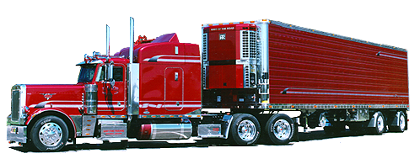
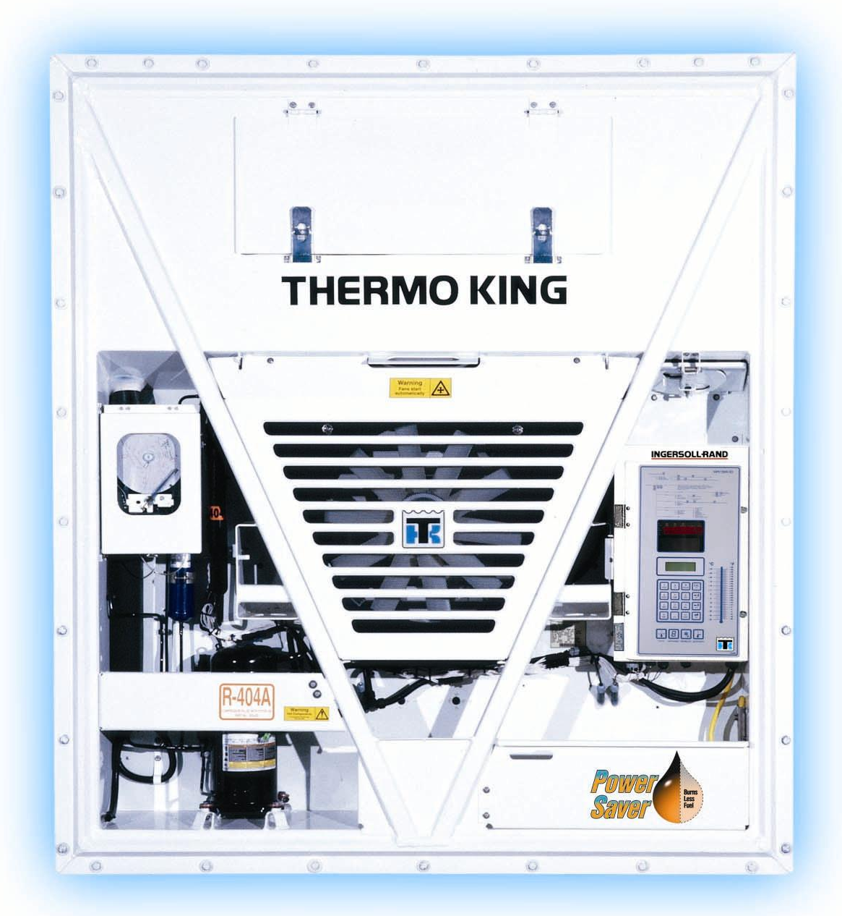
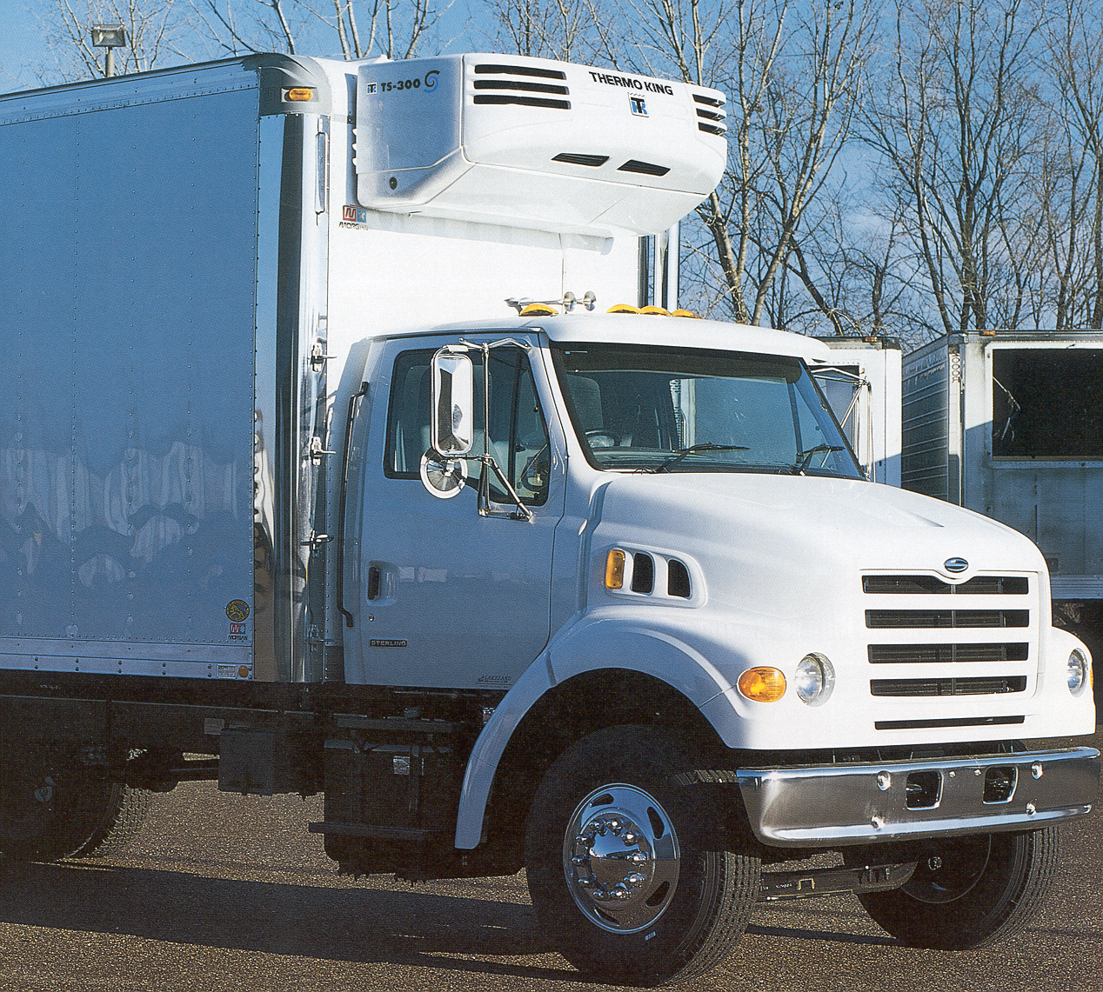
WHAT ARE REEFERS?
Machines that ‘Move Heat’

Slide 7
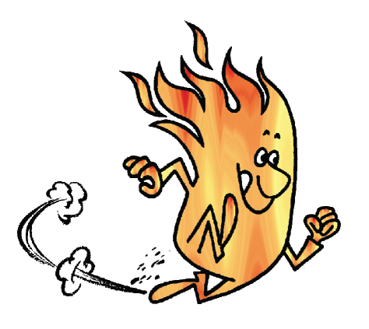


‘HOW’ DOES HEAT MOVE?
Warmer ⇒ Colder - ALWAYS!!!!!!!
‘Faster’ with Large Temp. Difference
Heat
Heat
Heat

Slide 8
‘HOW’ DOES IT MOVE?
Heat can move three (3) ways….
  1. Conduction
  2. Convection
  3. Radiation
Notes:
NEXT: Heat can move by any of these three methods.
NEXT: Conduction
NEXT: Radiation
NEXT: Convection
There are only these three ways heat can move. We will discuss each one individually.
NEXT

Slide 9

CONDUCTION
Heat moves through Solids & Liquids

Slide 10
CONDUCTION
Heat will move Between Solids and / or Fluids in direct contact with one another

Slide 11
CONDUCTION

Slide 12
Any other Examples of Conduction?
Notes:
Ask for other examples of conduction.
NEXT

Slide 13
CONVECTION
Definition - Heat transfers via the circulation (movement) of a fluid. i.e…..
  Air is a fluid
  Refrigerant Liquid & Vapor are fluids
Types
  ‘Natural’ Convection
  ‘Forced’ Convection
Notes:
Convection is the third method of heat transfer.
NEXT: Heat moves with a fluid as it circulates.
Circulation can be created by some kind of a pump or occur naturally.
NEXT: Air is considered to be a fluid, it is just thinner.
NEXT: Liquid and vapor refrigerant is considered a fluid.
NEXT

Slide 14

‘NATURAL’ CONVECTION
Warm Air Rises
Heater
Cool Air Falls

Slide 15
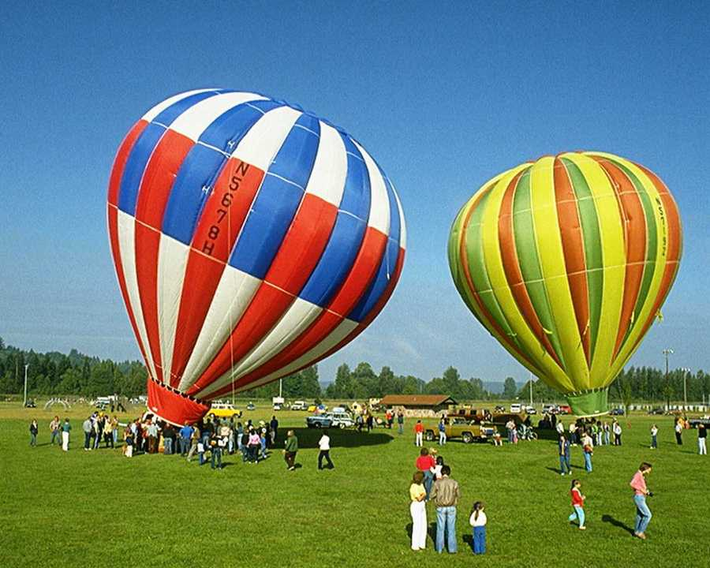
‘NATURAL’ CONVECTION

Slide 16
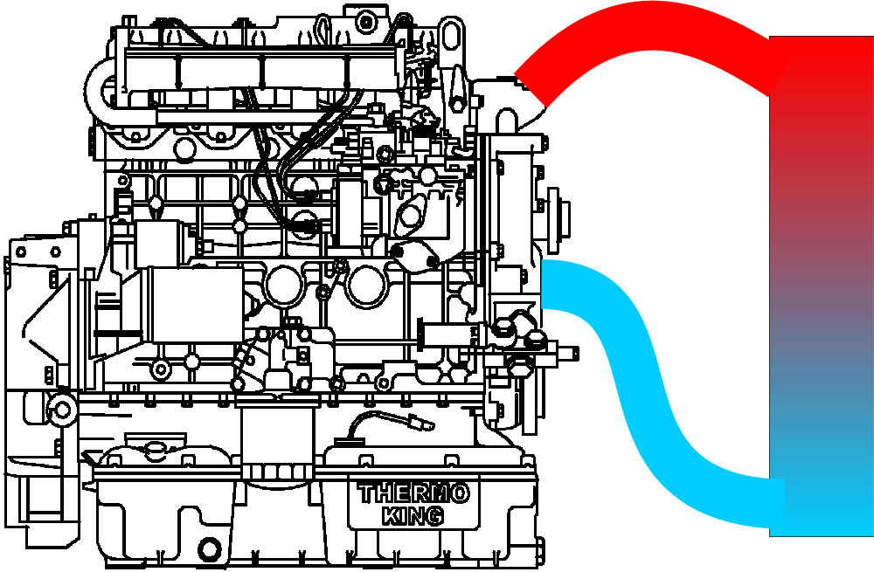
‘FORCED’ CONVECTION

Slide 17
‘FORCED’ CONVECTION

Slide 18
Any other Examples of Convection?
Notes:
Ask for other examples of Convection.
NEXT

Slide 19
RADIATION
Moves in Straight Lines… like light
Does not heat the air it passes through
Raises temperature of the substance that absorbs it
Dark colors absorb ‘more’ heat…
Light colors absorb ‘less’ heat
Notes:
The next type of heat transfer is Radiation.
NEXT: It does not raise the temperature of the air as it passes through.
NEXT: Only when it strikes something and is absorbed does the temperature go up.
NEXT: The darker a color is the more radiant heat it will absorb. The lighter a color is the less radiant heat it will absorb.
NEXT: Radiant heat moves in straight lines like light.
What are other examples of Radiant heat? (sun)
Why does your car interior get so hot when it is out in the sun? Radiant heat will pass through clear glass. It warms the seats and is then trapped.
NEXT

Slide 20
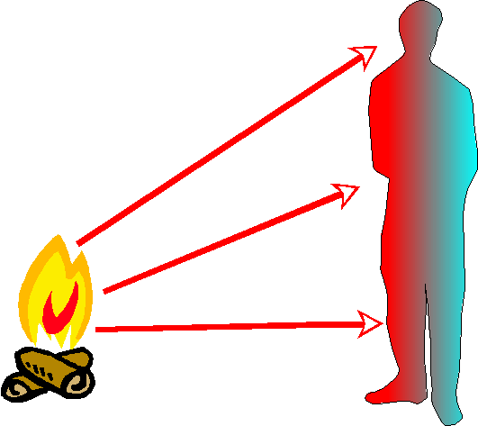
RADIATION

Slide 21
RADIATION

Slide 22
Any other Examples of Radiation?
Notes:
Ask for other examples of Radiant heat.
NEXT

Slide 23
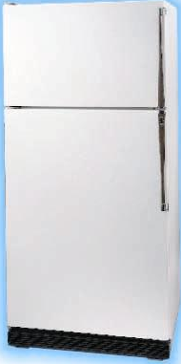
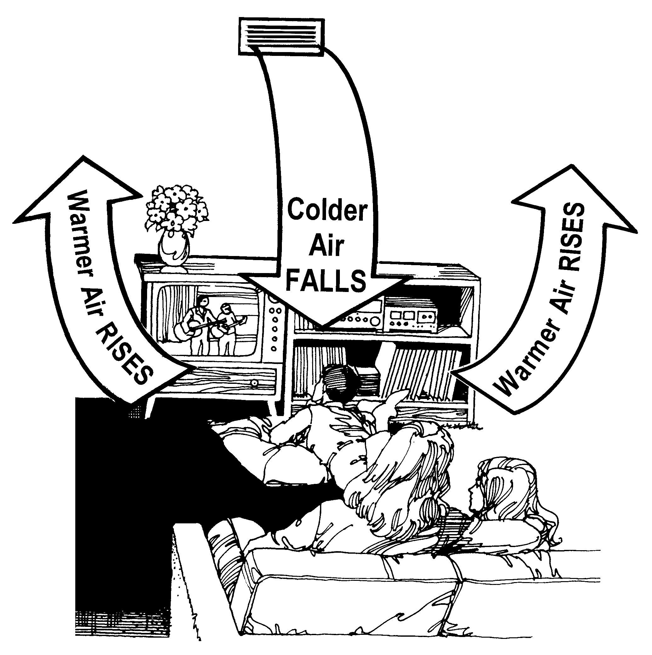
HEAT TRANSFER SYSTEMS
Usually combine ‘Conduction’ AND ‘Convection’ to move heat. i.e….

Slide 24
TERMS TO REMEMBER
Refrigeration
Heat
Box
Conduction
Convection
Radiation

Slide 25
HOW IS HEAT ‘MEASURED’?
Four (4) Ways….
  Temperature
  Sensible Heat
  British Thermal Unit (BTU)
  Specific Heat

Slide 26
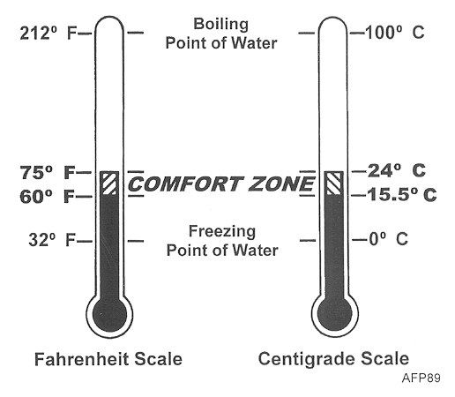
TEMPERATURE
Is the Level or Intensity of heat energy
Is measured in degrees
Fahrenheit or Centigrade
Can be ‘Felt’ or ‘Sensed’

Slide 27
TEMPERATURE
The temperature inside the controlled space (container) is called….
The temperature surrounding the
Container is called…
AMBIENT
Box Temperature
AMBIENT
AMBIENT
AMBIENT

Slide 28
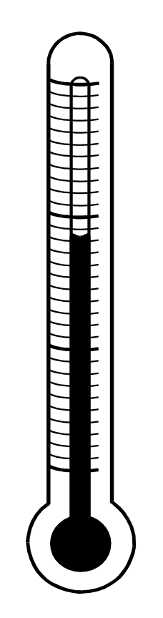
SENSIBLE HEAT
Is Heat you ‘Can Feel’
Is measured with a
Thermometer
Causes a change in
Temperature

Slide 29
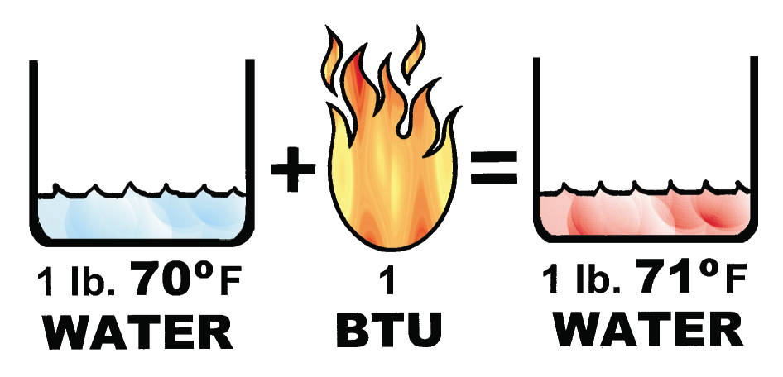
BRITISH THERMAL UNIT
Measure of the quantity (amount) of heat energy
Definition: A Btu is the amount of heat required to raise the temperature of one (1) pound of water one (1) degree F

Slide 30
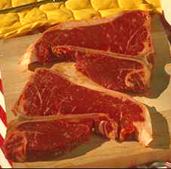
SPECIFIC HEAT
Amount of heat required to raise the temperature of one (1) pound of a ‘Specific Substance’ one (1) degree F.
i.e. 0.75
Compared to Water (1.0)
The less heat required to change substance temp., the lower the Specific Heat
The more heat required to change substance temp., the higher the Specific Heat

Slide 31
SPECIFIC HEAT EXAMPLES
Water - 1.0
Aluminum - .22
Honey - .35
Cheese - .50
Fresh Beef - .75
Vegetables - .90
Cucumbers & Watermelon - .97

Slide 32
TERMS TO REMEMBER
Temperature
Box Temperature
Ambient Temperature
Sensible Heat
Btu
Specific Heat

Slide 33
Questions?

